Slide 1
Automated Container Deployment and Administration in the Cloud

Slide 2
Network & System Administration CA 1
Name : Prakash Thangaraj
ID : 20095532
Course: MSc Information Systems

Slide 3
Agenda
Introduction
Tools
Architecture
Demo
Issues and Solutions
Learnings & Conclusion

Slide 4
Introduction
This project contain the small webpage cloud automation with end-to-end setup.
Built fully automated deployment pipeline for web application
Learning Automation by using AWS free tire in zero cost
Learning Devops tools in practice
See the web page in Live.

Slide 5
Tools and Technologies
Terraform - AWS infrastructure provisioning
Ansible - Server configuration & Docker setup
Docker - Containerization (Nginx Alpine)
GitHub – Version Control
GitHub Actions - CI/CD pipeline automation
AWS - Cloud platform (EC2, Elastic IP)

Slide 6
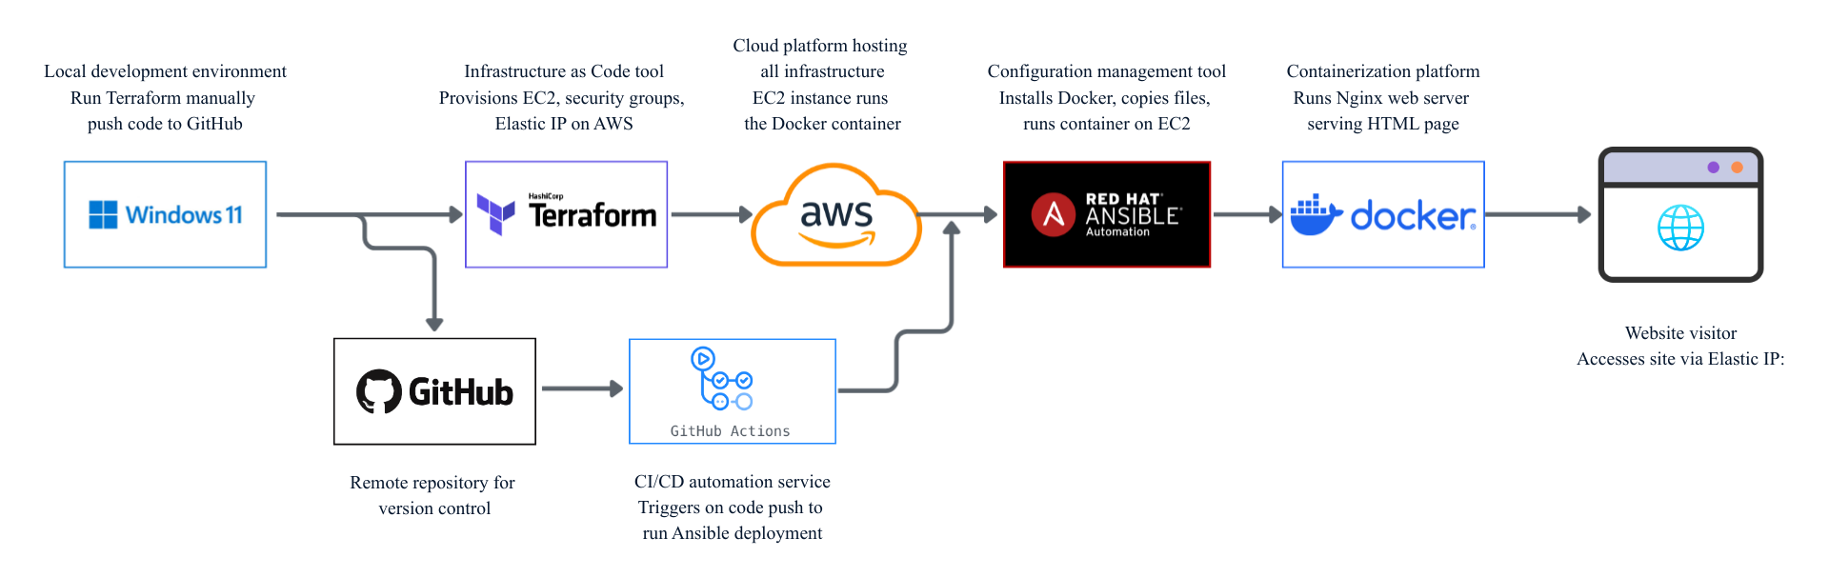
Architecture

Slide 7
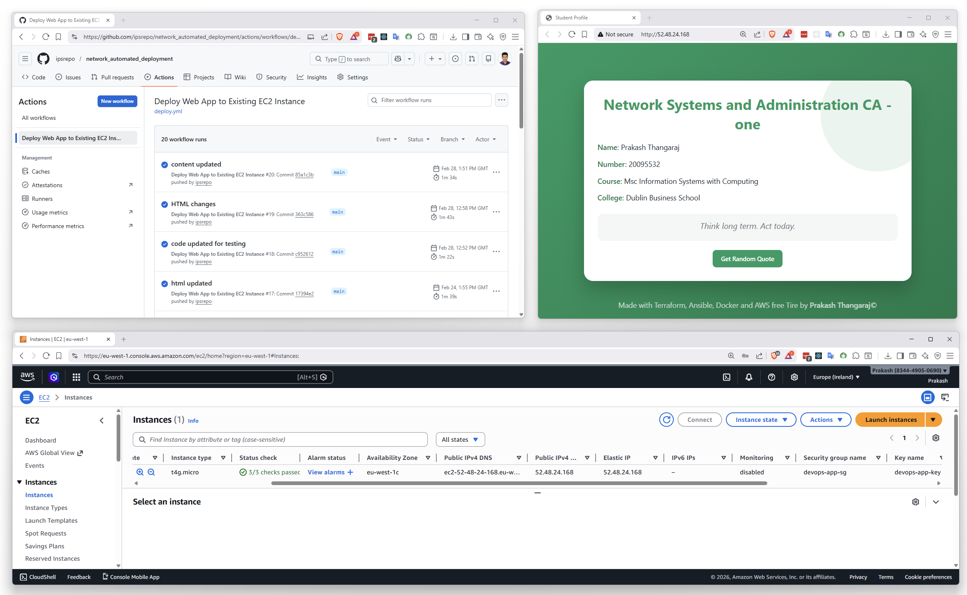
Demo

Slide 8
Issues and Solutions
Dynamic IP on instance creation
SSH key permission denied
Ansible not accessible in WSL
Local file changes not reflecting in the live site

Slide 9
Learnings & Conclusion
Tools integration is key to automation
Security groups must accommodate CI/CD runners
SSH key management in automated environments
Debugging pipeline failures systematically
Windows + WSL enables Linux tools on Windows

Slide 10
Thank you
Prakash Thangaraj
20095532@mydbs.ie

